Slide 1
New Automation Technology Beckhoff Automation

Slide 2
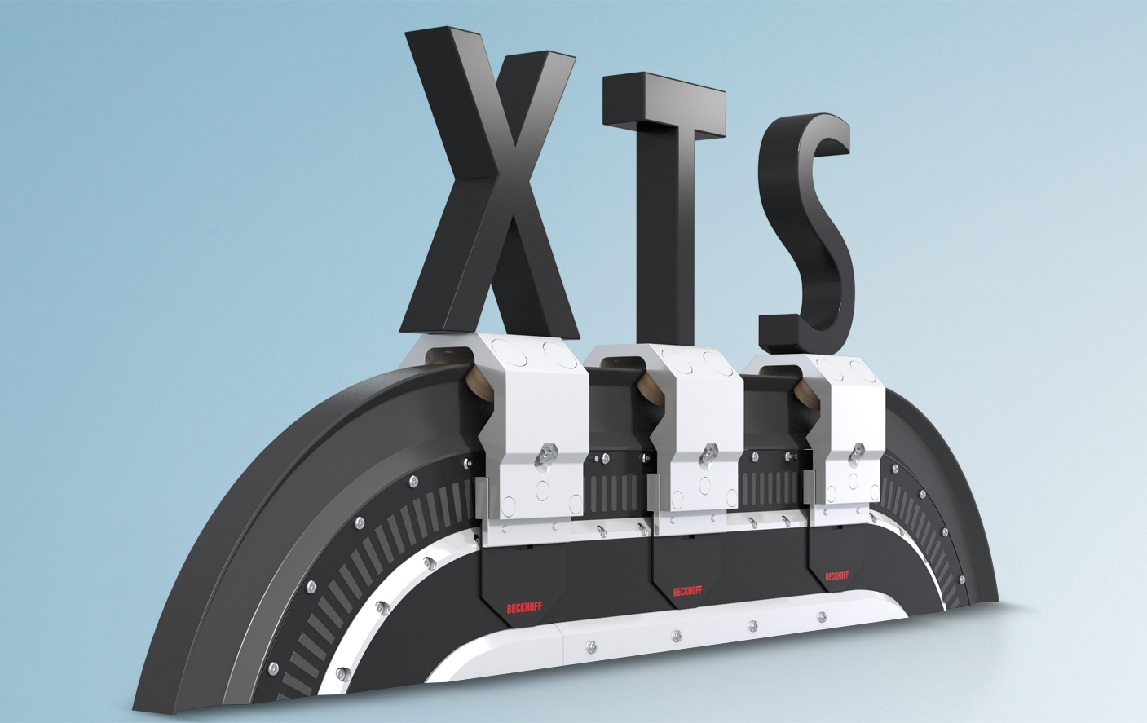
XTS Training

Slide 3
XTS – TcSoftDrive

Slide 4
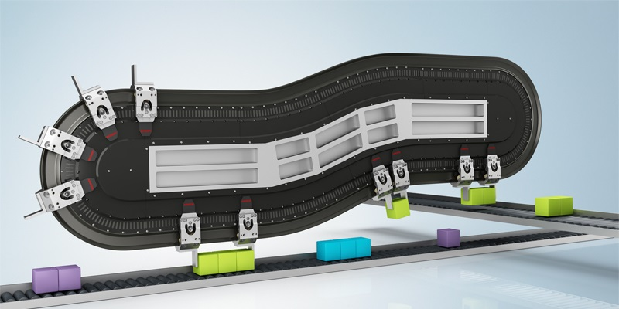
Agenda | XTS- TcSoftDrive
Short XTS basics
XTS Accuracy
XTS IPC & capabilities
Scope for Mover monitoring
TcSoftdrive structure & parameter
Tuning

Slide 5
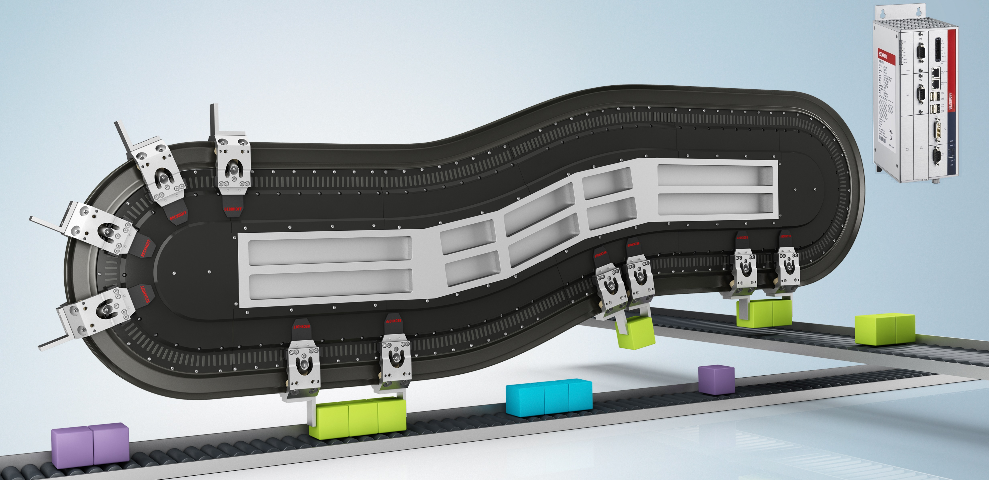
XTS – Overview and timing
Analog Signal from Positions sensor
complete Control-Cycel
for all Mover
in 250µs
Coil current set-point
Position calculation
Velocity calculation
Position control
Velocity control
Transformation current set-point into coil set-current

Slide 6
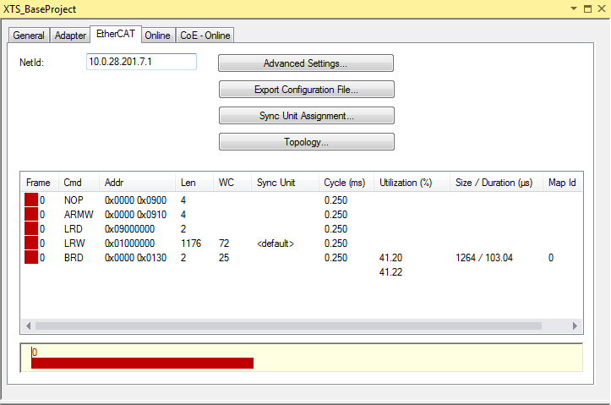
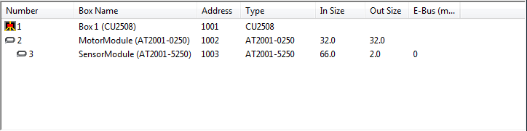
XTS – EtherCAT timing and data size
each Motor module has
15 Coils → 15 current set-values → 15 current act-values
2 Byte Status & 2 Byte Control
→ 32 Byte Process Image
each Sensor Module has
32 Position Sensors
2 Byte Status & 2 Byte Control
→ 66 Byte Process Image Input
EtherCAT data size 98 Byte

Slide 7
XTS – EtherCAT timing and datasize
per Frame max. data size of 1500 Byte
per Module (Motor & Sensor)
data size of 98 Byte
3m XTS-Track → 12 Modules
12 x 98 Byte = 1176 Byte Data
Full Frame size = 1264 Byte Data
Frame runtime = 103 µs

Slide 8
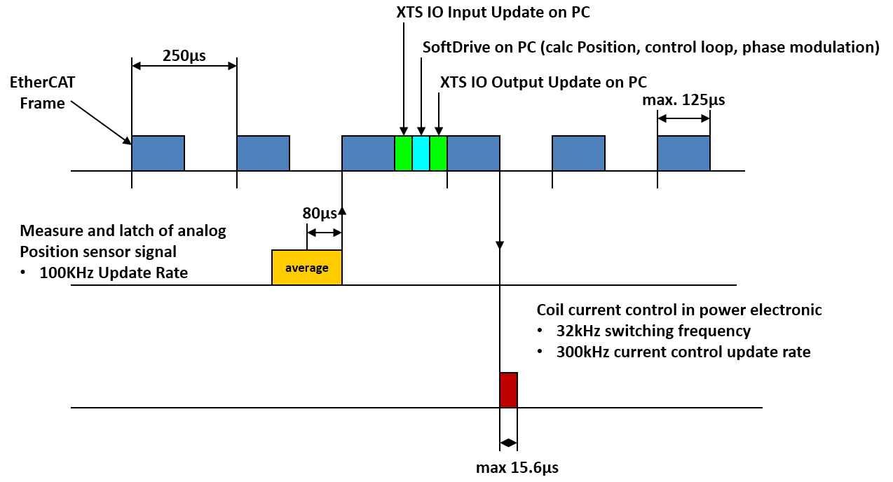
XTS – Basic Timing
Notes:
Erfassung der Wegmesssignale – Acquisition of the position feedback: 100KHz update rate
Mittelwert-bildung – Calculation
Verarbeitung in der Leistungselektronik – Processing in the power electronics: -32KHz Switching frequency – 300KHz current controller update rate

Slide 9
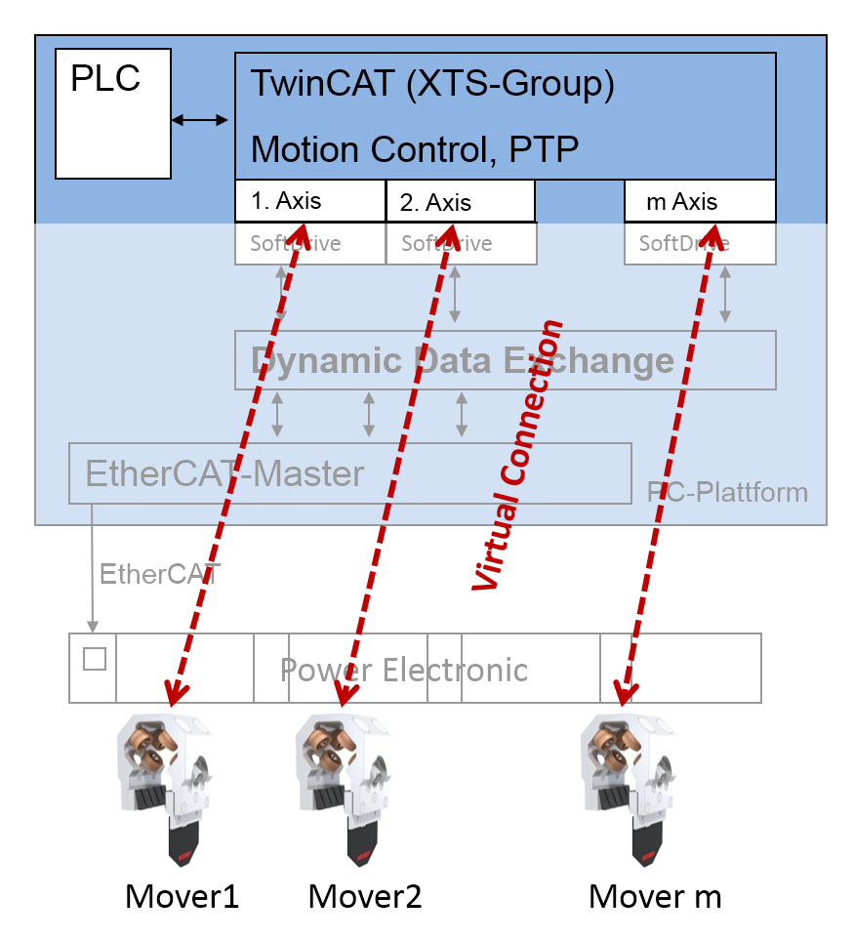
XTS – TwinCAT integration
From the point of view of application programming, a mover looks like a „standard“ servo NC axis.
New standard tasks are available:
Collision avoidance CA
Group building
Synchronous mechanisms
Runs on powerful Beckhoff Standard IPCs with EtherCAT-Port
Simulation mode is possible for TcSoftDrive

Slide 10
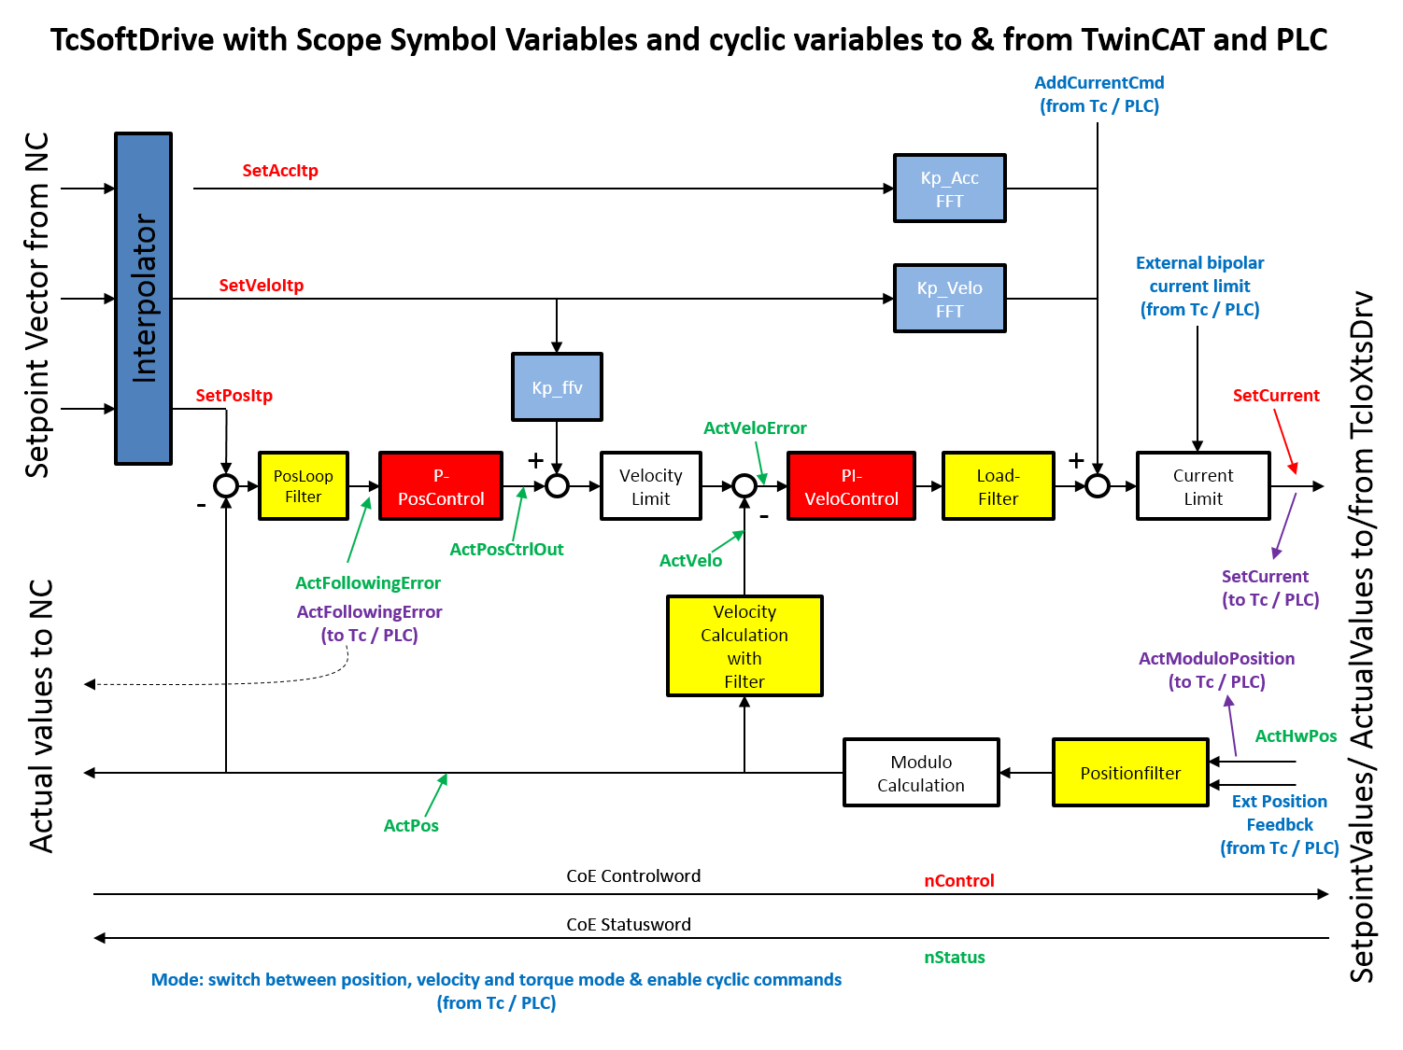
XTS – TcSoftDrive control loop structure

Slide 11
Agenda | XTS- TcSoftDrive
Short XTS basics
XTS Accuracy
XTS IPC & capabilities
Scope for Mover monitoring
TcSoftdrive structure & parameter
Tuning

Slide 12
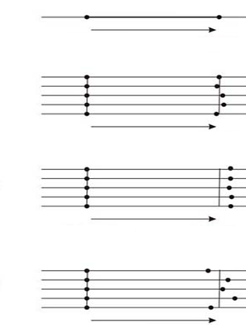
XTS - Definition of Accuracy
Start Position
Target Position
Ideal Positioning
High Accuracy
High Repeatability
Low Accuracy
High Repeatability
Low accuracy with high repeatability can be compensated.
Low repeatability cannot be compensated
Low Accuracy
Low Repeatability

Slide 13
XTS - Position Accuracy (Sensor Rev. 18)
XTS Datasheet
Absolute Position Accuracy | ± 250µm (within one straight Module) *
Tested but not specified Accuracy
Achievable Position Accuracy | ± 150µm (within one straight Module) **
* Typical achievable absolute accuracy, this can become larger due to thermal expansion of the module (∆ϑ ≥ 30°C) or Parallelism of the flag to the encoder module and the orthogonality of the Encoder Flag to the Motor Module.
** typically achievable accuracy in a straight module between 15 - 235mm (Encoder flag completely in a single module) a parallel and orthogonal Encoder flag and a thermal expansion of while in operation (∆ϑ ≤ 15°C)
XTS Datasheet
Position accuracy while at speed | ± 150µm @ 1.5m/s (in a straight module) *
Tested but not specified Accuracy
Position accuracy while at speed in the curve | ± 400µm @ 1m/s (in a 180° Curve Module) **
* the synchronization accuracy is very dependent on the mechanical stiffness and the load on the mover and the controller settings. The mechanical displacement between the modules also plays an important role
** the deviation in the curve can be much, much worse if the center of gravity is not directly between the magnets of the mover
XTS Datasheet
Stand Still Repeatablity | ± 10µm (unidirectional) *
* repeatability for the encoder flag the stand still repeatability may fail due to the defects in the rail system or a Roller developing a flat spot or bearing failure or thermal extension

Slide 14
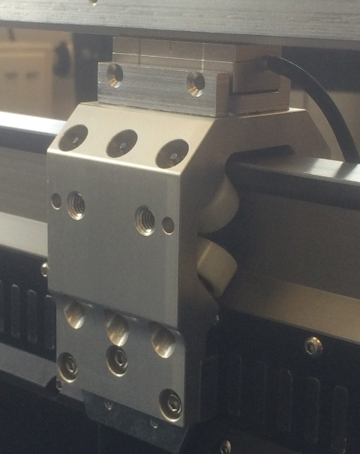
XTS - Position Accuracy measurements
Absolute Position Accuracy measured against an very precise optical encoder

Slide 15
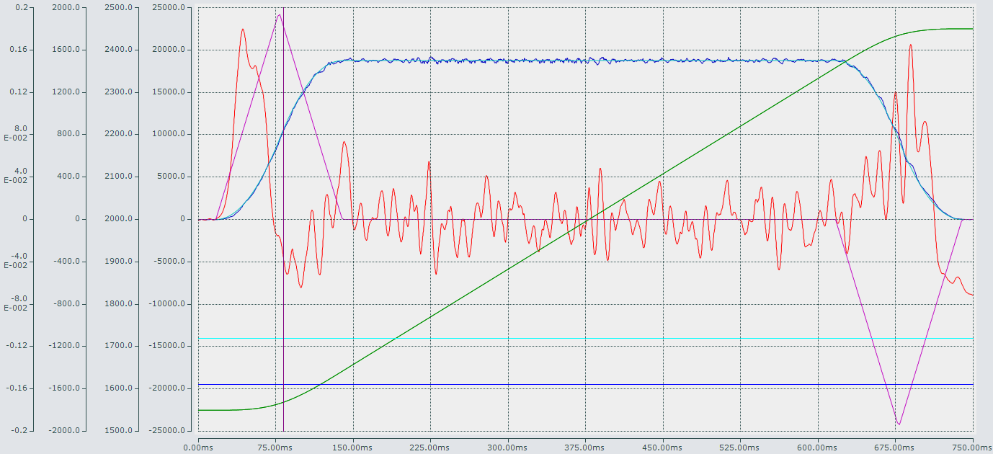
XTS - Position Accuracy while moving
Measurement in the straight section at 1.5m/s with a tuned 12 Roller mover and no load
Position deviation in Lag Distance is less than ± 60µm

Slide 16
XTS - Increasing Accuracy best Practices
Possible solutions if the accuraccy is not sufficient
Absolute accuracy of all Movers | Adapt the target position of the commands from the PLC based on previously measured and stored values. Mechanically position the tooling at the processing station, e.g. a pin to center the tooling. Use an External encoder feedback such as a laser distance sensor or a highly accurate quick Vision System - a balance during positioning would thereby therefore Possible
Absolute Accuracy between movers | Position offset in the NC. Each mover must be teached and a unique identification required External encoder or a laser distance sensor or a highly accurate quick Vision System - a correction during positioning would thereby also possible
Positional accuracy over several modules / synchronization accuracy | Setting a position offset in TcIoXts drivers per module (very time consuming) Sometimes AREA control parameters in TcSoftDrive can be adjusted to ensure a smoother ride Sometimes an additional counter-weight mass on the Mover can help bring the center of gravity to the middle of the magnets, thus improving the synchronous accuracy and travel through the curve

Slide 17
Agenda | XTS-TcIoXts
Short XTS basics
XTS Accuracy
XTS IPC & capabilities
Scope for Mover monitoring
TcSoftdrive structure & parameter
Tuning

Slide 18
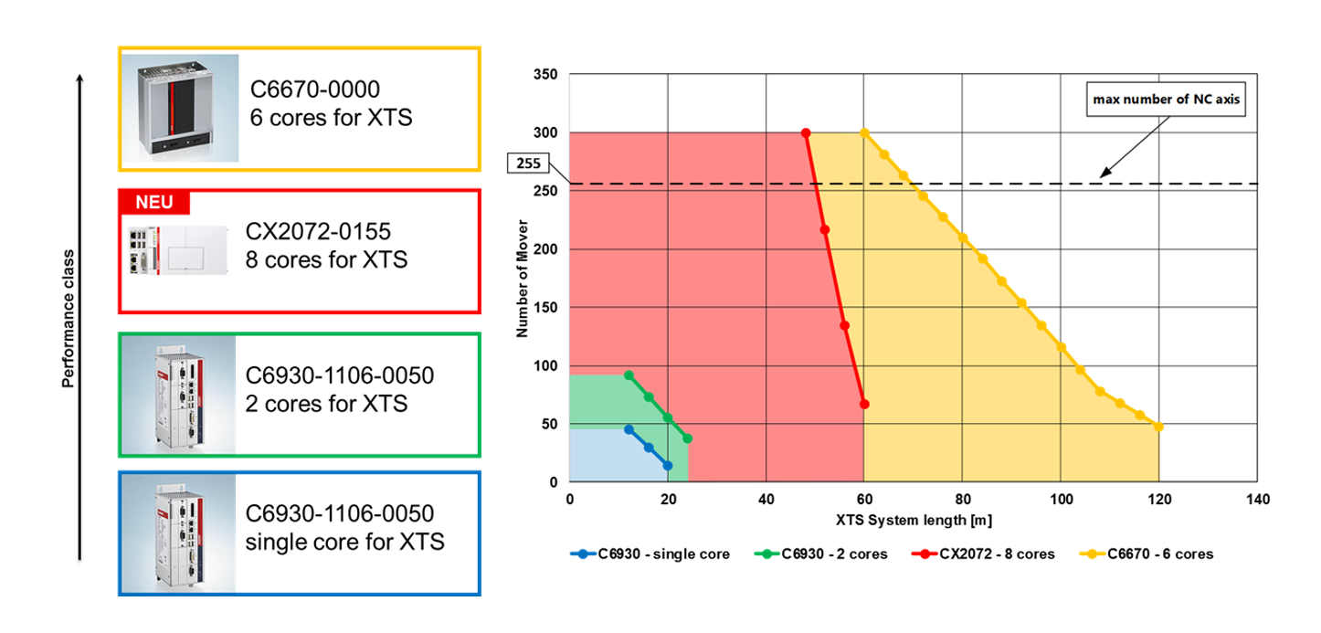
XTS IPC & capabilities

Slide 19
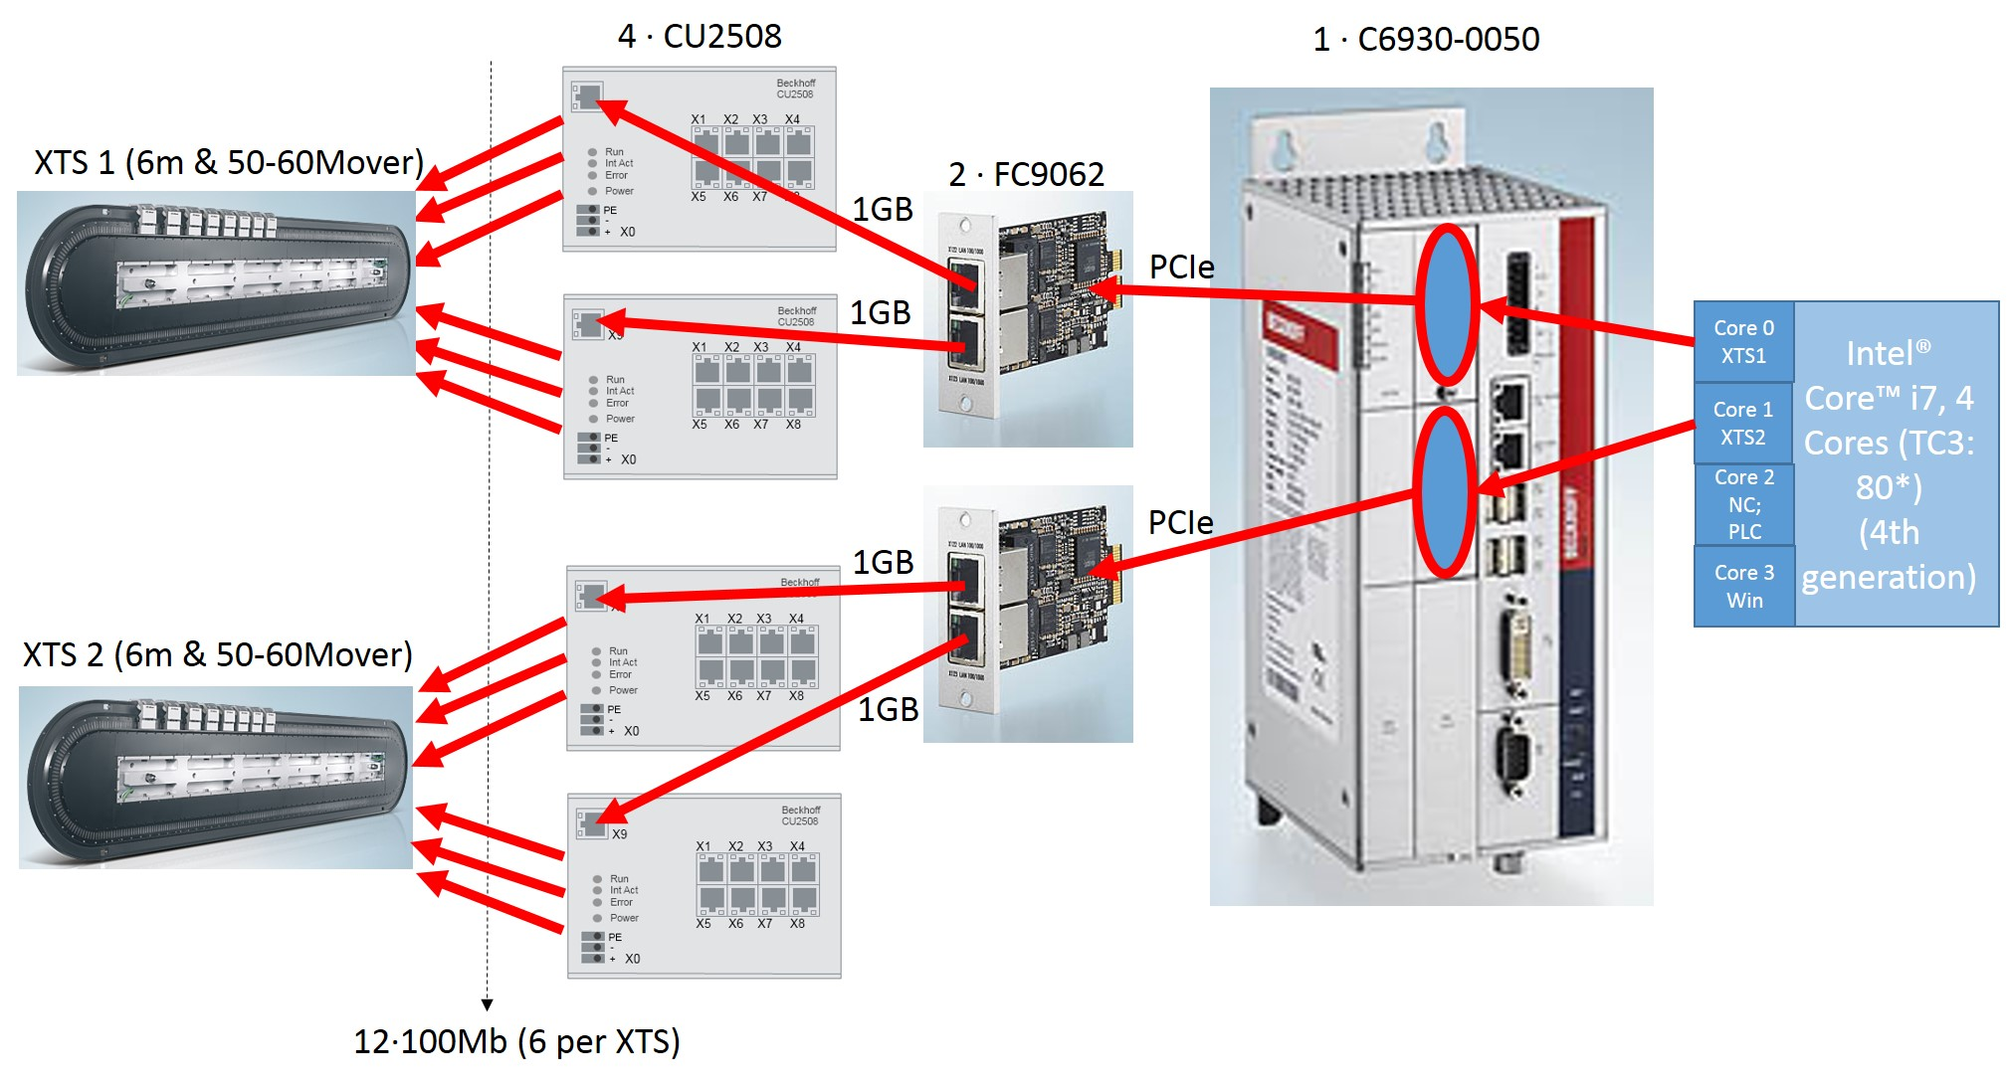
XTS – IPC C6930 Core™ i7 application examples

Slide 20
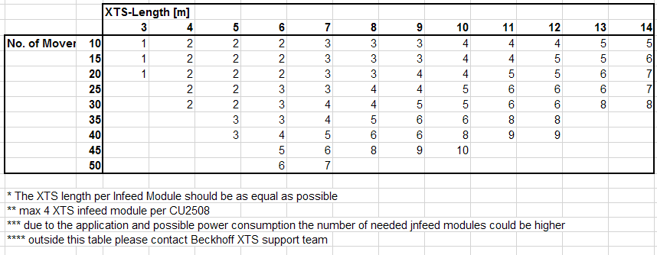
XTS – IPC C6930 Core™ i7 current possible size

Slide 21
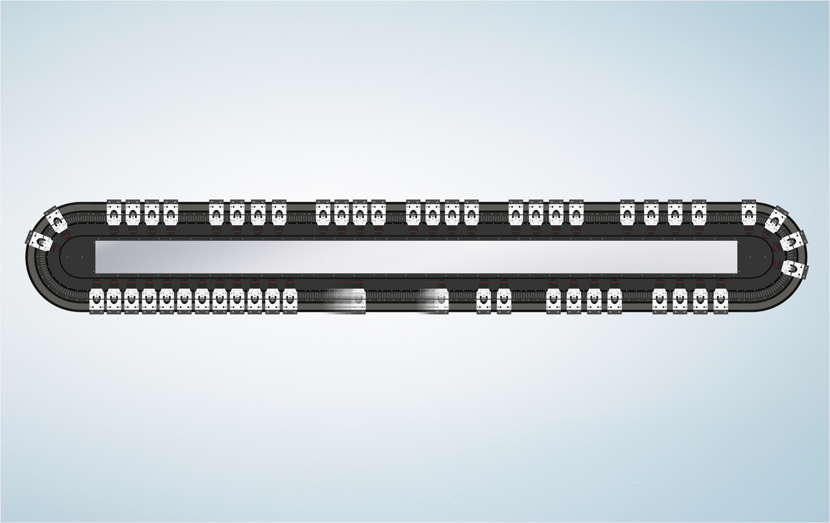
XTS – Capabilities coming soon
Maximum circumference of 18 m
Maximum 80 movers on a track
Restrictions are purely due to data gathering and processing requirements
The mover count and circumference will continue to increase in coming years

Slide 22
Agenda | XTS- TcSoftDrive
Short XTS basics
XTS Accuracy
XTS IPC & capabilities
Scope for Mover monitoring
TcSoftdrive structure & parameter
Tuning

Slide 23
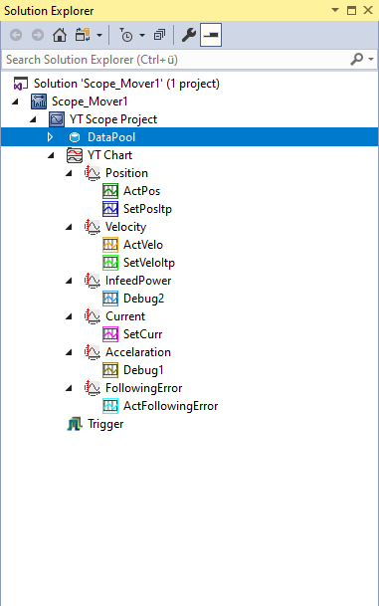
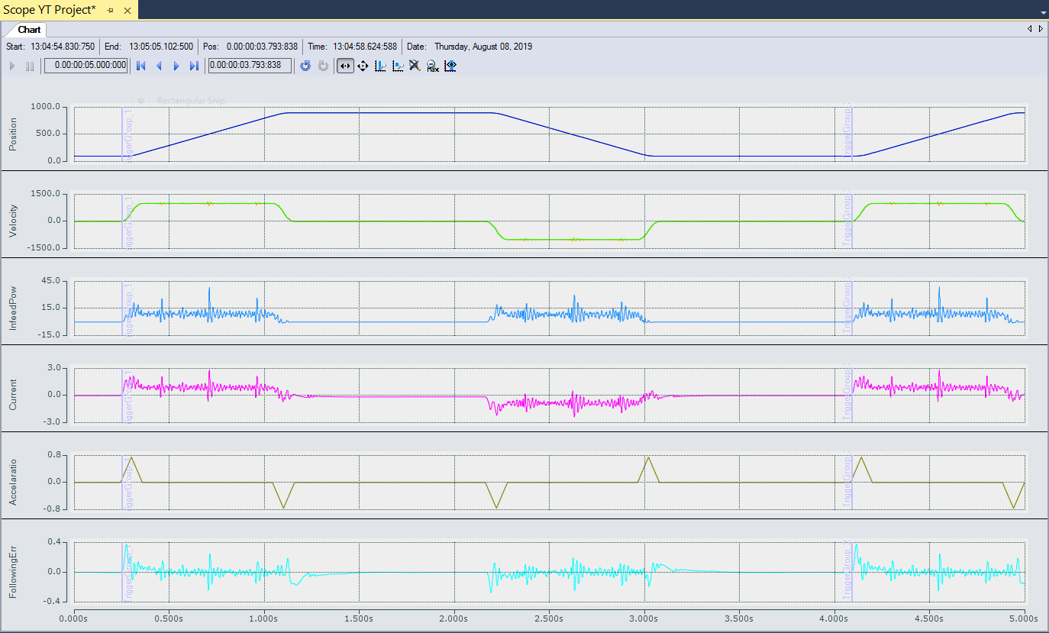
XTS TcSoftDrive – Scope for Mover monitoring

Slide 24
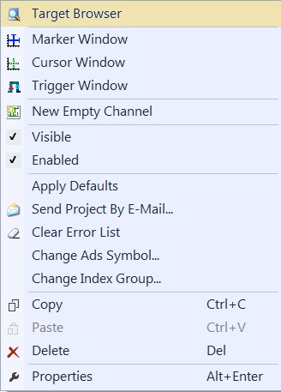
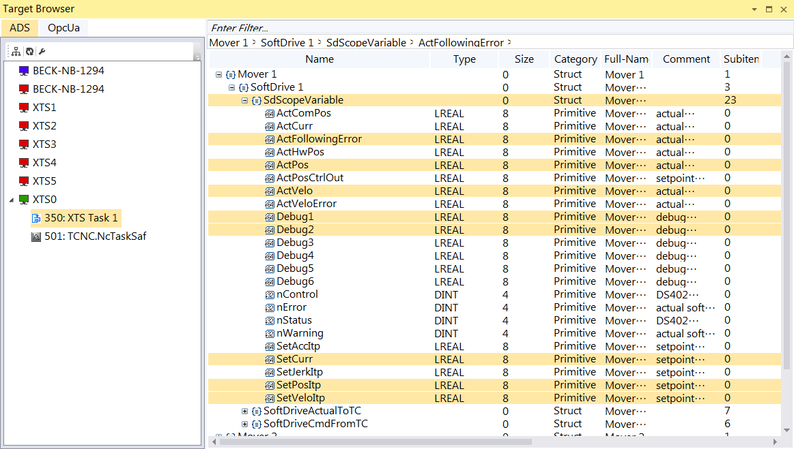
XTS TcSoftDrive – Signal selection for monitoring

Slide 25
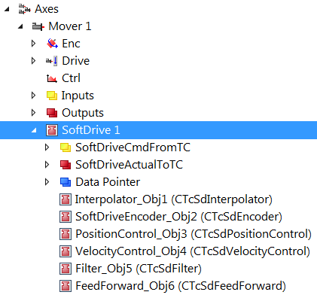
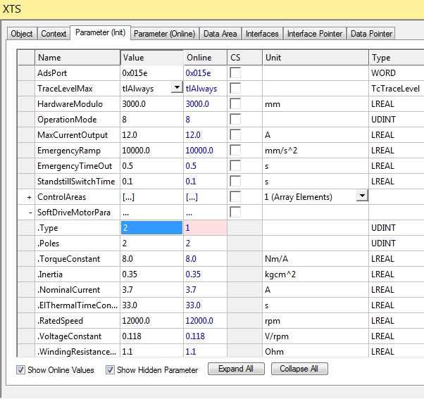
XTS TcSoftDrive – Setup Motor-Parameter for monitoring
Change Parameter Motor.Type 1 → 2
- Variable Debug2 will be filled with InfeedPower
set “Show Hidden Parameter” first

Slide 26
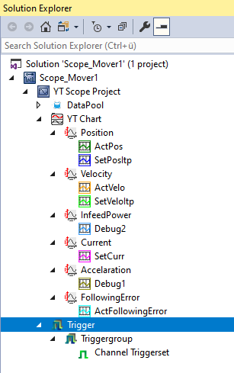
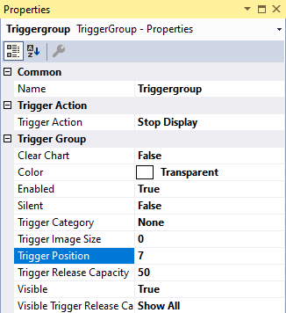
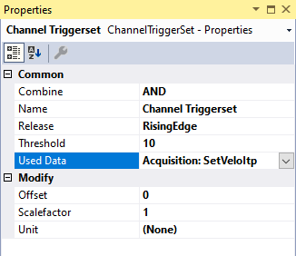
XTS TcSoftDrive – Trigger settings for monitoring

Slide 27
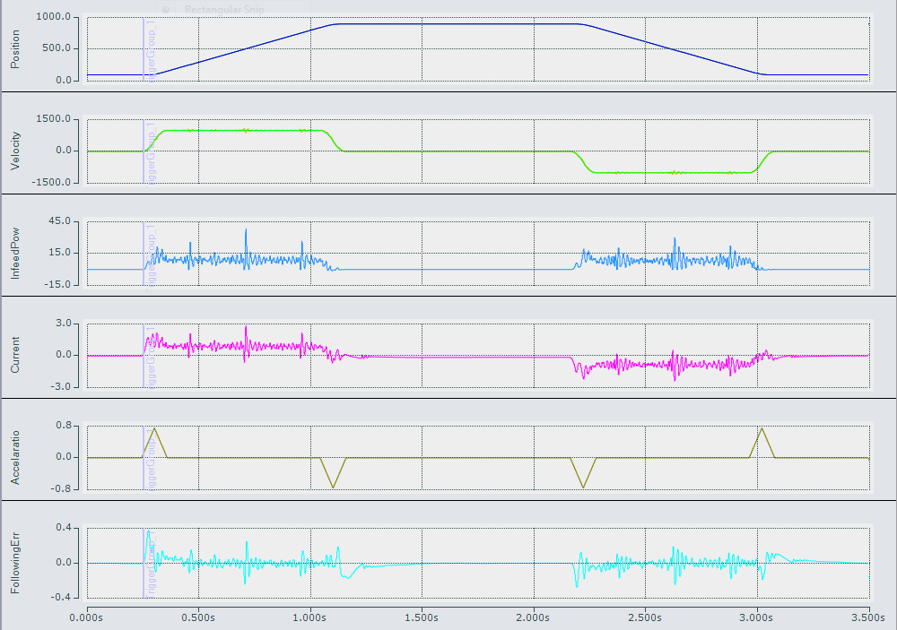
XTS TcSoftDrive – Power monitoring example
Position [mm]
Velocity [mm/s]
Infeed Power [W]
Mover Current [A]
(this is different to the infeed current on the 48V DC!!!)
Acceleration [mm/s²]
FollowingError [mm]

Slide 28
Agenda | XTS- TcSoftDrive
Short XTS basics
XTS Accuracy
XTS IPC & capabilities
Scope for Mover monitoring
TcSoftdrive structure & parameter
Tuning

Slide 29
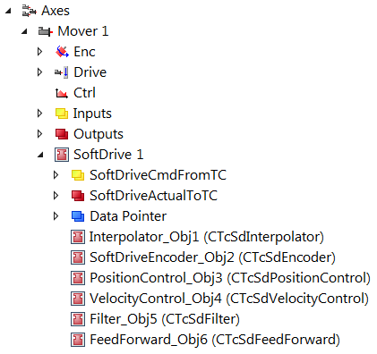
XTS TcSoftDrive

Slide 30
XTS TcSoftDrive - parameter structure
General SoftDrive Parameter
Parameter for Interpolator
Parameter for Position calculation
Parameter for Position Control
Parameter for Velocity Control
Parameter for Filter settings
Parameter for feedforward control

Slide 31
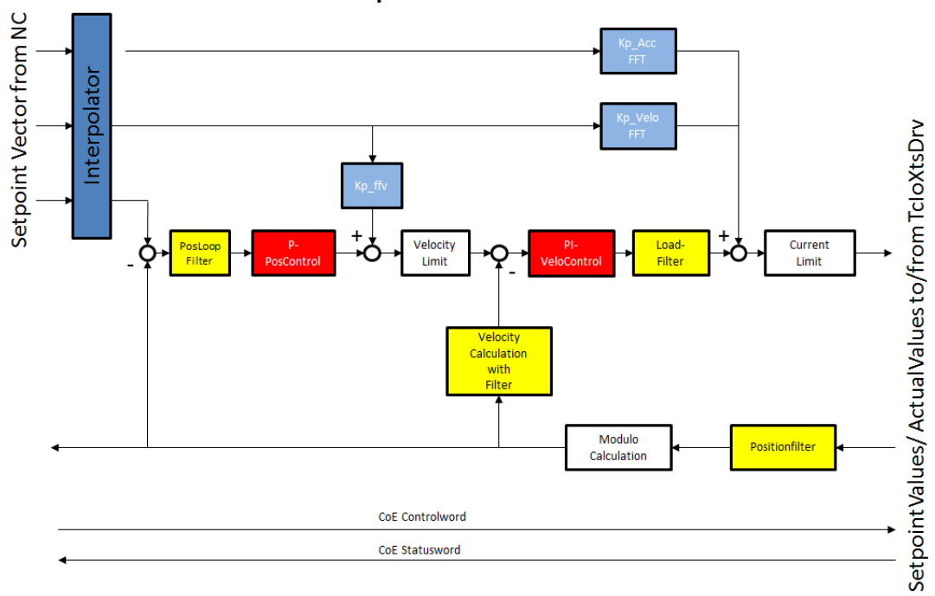

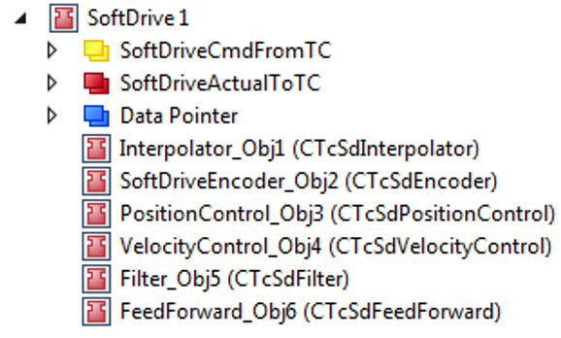
XTS TcSoftDrive - parameter structure

Slide 32
XTS TcSoftDrive - parameter structure

Slide 33
XTS TcSoftDrive - parameter structure

Slide 34
XTS TcSoftDrive - parameter structure

Slide 35
XTS TcSoftDrive - parameter structure

Slide 36
XTS TcSoftDrive - parameter structure

Slide 37
XTS TcSoftDrive - parameter structure

Slide 38
XTS TcSoftDrive - parameter structure

Slide 39
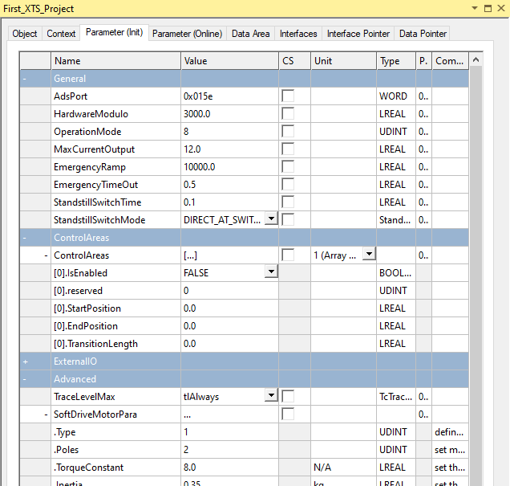
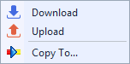
XTS TcSoftDrive - General SoftDrive Parameter

Slide 40

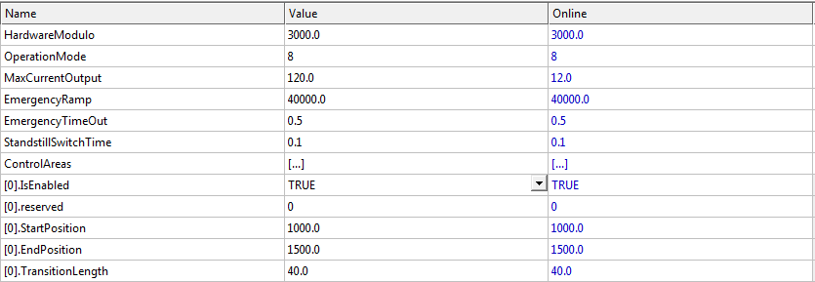
XTS TcSoftDrive - 32 different control areas
1 up to 32 different control areas
Different parameter for position and velocity control
Different current limit could be set in Feedforward module
To use a certain control area [X].IsEnabled must be set to TRUE and Activate Configuration

Slide 41
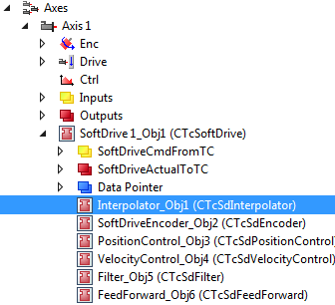
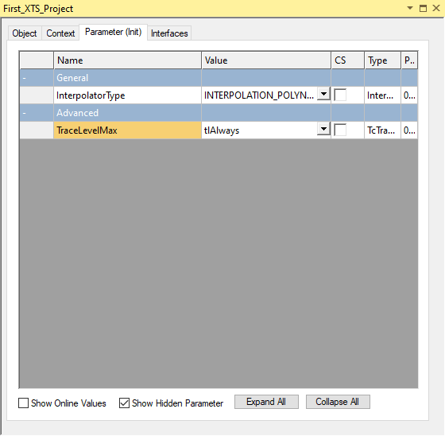
XTS TcSoftDrive - Interpolator

Slide 42
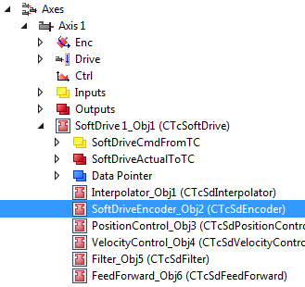
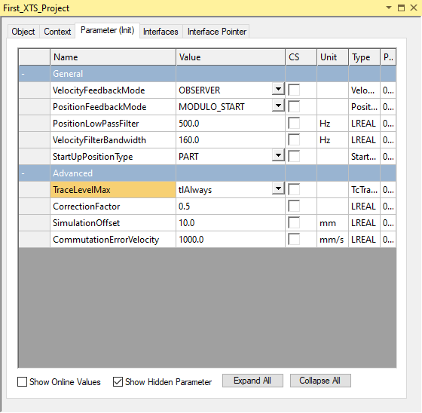
XTS TcSoftDrive - Encoder

Slide 43
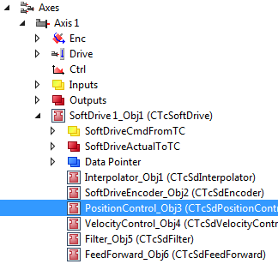
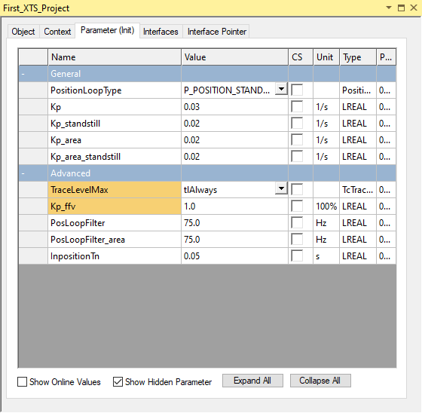
XTS TcSoftDrive - position control

Slide 44
XTS TcSoftDrive - parameter for position control
Type: P_Position
only Kp is used
Type: P_Position_Standstill
Kp &
Kp_standstill is used
Type: P_Position_Standstill_Area
all parameter are used

Slide 45
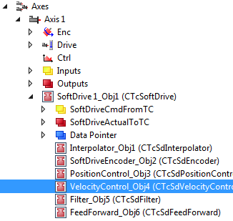
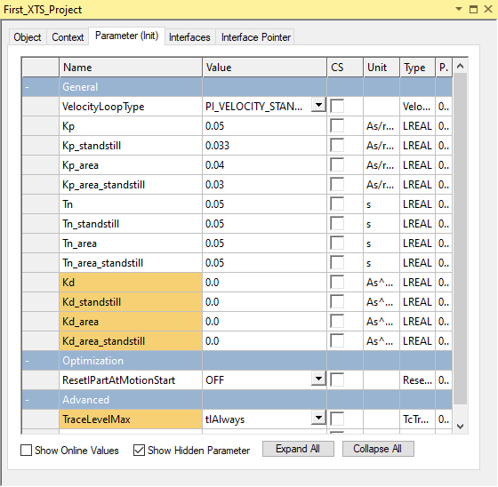
XTS TcSoftDrive - velocity control

Slide 46
XTS TcSoftDrive - parameter for velocity control
Type: PI_Position
only Kp & Tn is used
Type: PI_Velocity_Standstill Kp/Kp_standstill & Tn/Tn_standstill is used
Type: PI_Velocity_Standstill_Area
all Kp and Tn are used (standstill & area)

Slide 47
XTS TcSoftDrive - parameter for velocity control
If one integral parameter is set to zero then the calculated value is also reset to zero.
If an old tmc is used the functionality is backward compatible

Slide 48
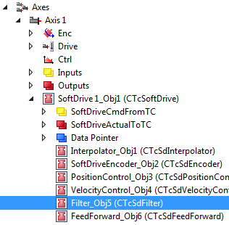
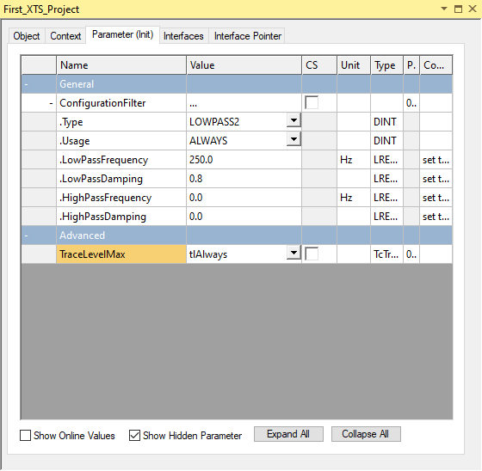
XTS TcSoftDrive - filter parameter

Slide 49
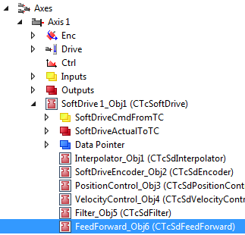
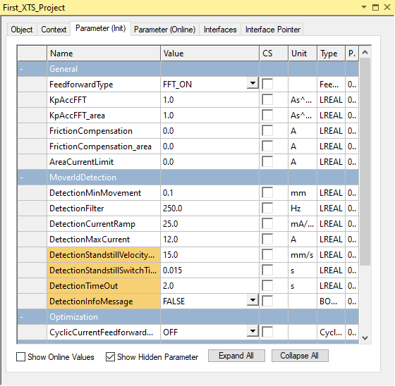
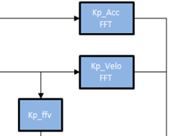
XTS TcSoftDrive - Feed Forward

Slide 50
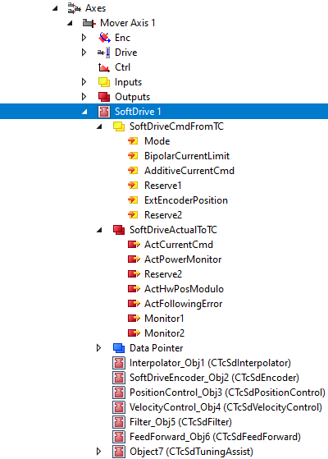
XTS TcSoftDrive - cyclic variables
From NC / PLC → TcSoftDrive
Mode: change TcSoftDrive operation mode & the use of the other cmd values
BipolarCurrentLimit: add the cyclic current limit value
AdditiveCurrentCmd: set an additional cyclic FFT current value. Functionality depends on the actual Operation mode used for real torque control
AdditiveCurrentCmd: add an additional cyclic FFT current value
ExtEncoderPosition: use position data from another source

Slide 51
XTS TcSoftDrive - cyclic variables
From TcSoftDrive → NC / PLC
ActCurrentCmd: actual current command
ActHWPosModule: actual HW Position
ActFollowingError: actual Following Error

Slide 52
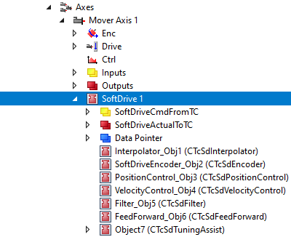
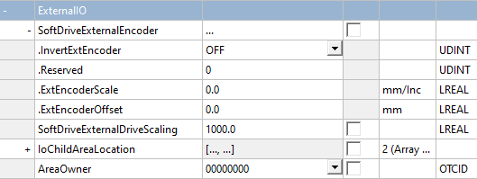
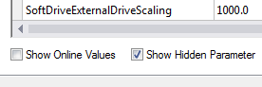
XTS TcSoftDrive - setting for cyclic data
SoftDriveExternalEncoder
These parameters set the encoder counting direction, the scaling and offset for the external encoder feedback. This external encoder position could also be the position from another XTS mover.
SoftDriveExternalDriveScale
This parameter sets the scaling for the output of the actual SoftDrive current command e.g. for use with another drive HW

Slide 53
Agenda | XTS- TcSoftDrive
Short XTS basics
XTS Accuracy
XTS IPC & capabilities
Scope for Mover monitoring
TcSoftdrive structure & parameter
Tuning

Slide 54
XTS TcSoftDrive – Tuning
Servo systems typically use a combination (cascaded) of three types of control loops:
current loop (indirectly via the filter settings)
velocity loop
and position loop
To tune the system, we have to tune each loop.
Starting at the first loop (current indirectly via the filter settings )

Slide 55
XTS TcSoftDrive – Tuning
Tuning Sequence
Setup Filter Settings
on the straight section
on the curve section
Setup Velocity-Control
on the straight section
on the curve section
Setup Position-Control
on the straight section
on the curve section

Slide 56
XTS TcSoftDrive – Tuning
Tuning Sequence
Setup Filter Settings
on the straight section
on the curve section
Setup Velocity-Control
on the straight section
on the curve section
Setup Position-Control
on the straight section
on the curve section

Slide 57
XTS TcSoftDrive – Tuning
Tuning Sequence
Setup Filter Settings
on the straight section
on the curve section
Setup Velocity-Control
on the straight section
on the curve section
Setup Position-Control
on the straight section
on the curve section

Slide 58
XTS TcSoftDrive – Tuning
Tuning Sequence
Setup Filter Settings
on the straight section
on the curve section
Setup Velocity-Control
on the straight section
on the curve section
Setup Position-Control
on the straight section
on the curve section

Slide 59
XTS TcSoftDrive – Tuning
Setup Filter Settings
To determine the Filter Settings there is a Tuning Assist
The Tuning Assist suggests values to adjust the filters and feedforward parameters
Typically only the Velocity and Position loops need to be tuned afterwards

Slide 60
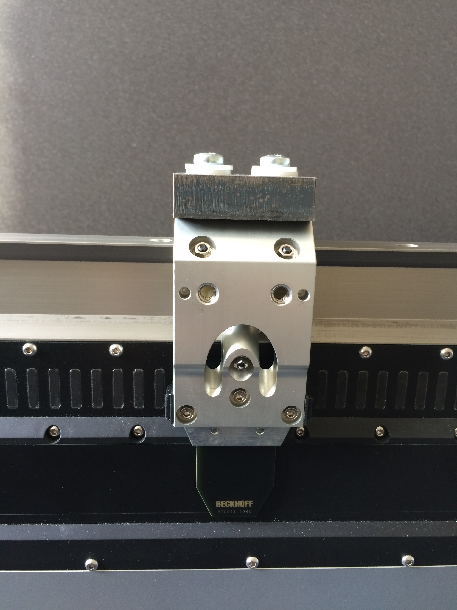

XTS TcSoftDrive – Tuning Tuning Assist
Determining Filter Settings using Tuning Assist
The Tuning Assist (TA) TcCom object is added to the existing TcSoftDrive module (Version ≥ 3.10.43.0)
The TA function operates in torque mode and generates a short current to the mover, followed by coasting to a stop. The Mover will be driven in both positive and negative directions and two measurements will be taken.
Risk of injury from moving movers
When the Tuning Assist function is started the mover starts to move open loop with a jump. There is a risk of injury to body parts. Keep an appropriate safety distance, and stay clear outside of the operating space.
WARNING

Slide 61
XTS TcSoftDrive – Tuning Tuning Assist
Determining Filter Settings using Tuning Assist
The response of the system (Mover with tooling) will be measured and a Fast Fourier Transformation (FFT) is used to determine the frequency components
The result could be visualized with the array bar chart functionality of TwinCAT 3 Scope Views (Version ≥ 3.2.3136 starting with TwinCAT 3.1.4020.14)
Risk of injury from moving movers
When the Tuning Assist function is started the mover starts to move open loop with a jump. There is a risk of injury to body parts. Keep an appropriate safety distance, and stay clear outside of the operating space.
WARNING

Slide 62
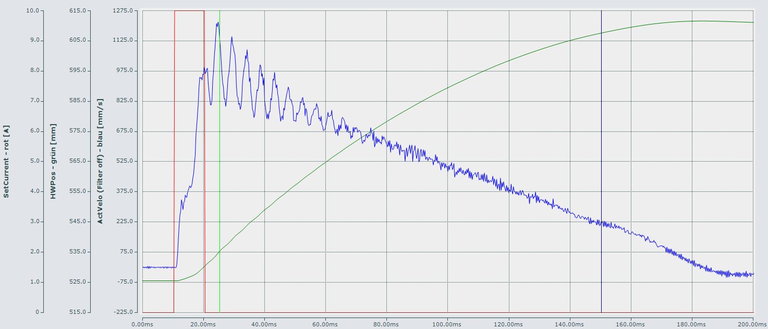
XTS TcSoftDrive – Tuning Tuning Assist
Determining Filter Settings using Tuning Assist
The behaviour (torsional oscillation) of the mechanical system is analyzed. The normal direction of motion for the application should be used to ensure the best parameterization of the control loops for optimal motion performance.
Notes:
The scope view example shows the oscillation response over time when a current is applied to the mover.

Slide 63
XTS TcSoftDrive – Tuning Tuning Assist
Determining Filter Settings using Tuning Assist
The direction of torsional oscillations is shown in the picture on the right by the red double arrow
The scope view example shows the oscillation response over time when a current is applied to the mover.
Notes:
The scope view example shows the oscillation response over time when a current is applied to the mover.

Slide 64


XTS TcSoftDrive – Tuning Tuning Assist
Determining Filter Settings using Tuning Assist
Add a TuningAssist object to an existing TcSoftDrive

Slide 65

XTS TcSoftDrive – Tuning Tuning Assist
Determining Filter Settings using Tuning Assist
Set the context task of the TuningAssist object to the same XTS task the TcSoftDrive is using
Activate the configuration and restart TwinCAT
In the Tuning Assist Obj. set the TcSoftDrive automatic parameter to Mode 10 (force mode)

Slide 66

XTS TcSoftDrive – Tuning Tuning Assist
Determining Filter Settings using Tuning Assist
Create a new measurement project and choose “Scope Array Bar Project” as the type

Slide 67


XTS TcSoftDrive – Tuning Tuning Assist
Determining Filter Settings using Tuning Assist
Add the array variable “SdTaBarChartVar2” to the Scope Axis

Slide 68


XTS TcSoftDrive – Tuning Tuning Assist
Determining Filter Settings using Tuning Assist
Set the properties of the variable “SdTaBarChartVar2”:
X Offset is set to 60 and
X Scale Factor is set to 10
The calculated frequency spectrum by the FFT is always calculated from 60 Hz to 600 Hz in 10 Hz steps

Slide 69


XTS TcSoftDrive – Tuning Tuning Assist
Setup Position Leg Monitoring
Set the following error monitoring to a high value e.g. 500mm (or disable it)

Slide 70


XTS TcSoftDrive – Tuning Tuning Assist
Determining Filter Settings using Tuning Assist
Process control is done by OnlineWrite and OnlineRead to the parameter “TuningProcess”
The Online-Value shows the actual state of the “TuningProcess”
TuningProcess Settings:
TUNING_ASSIST_OFF
START_MEASURE
TUNING_ASSIST_ERROR
BUSY_MEASURE
DONE_MEASURE
BUSY_SPEC_CALC1
BUSY_SPEC_CALC2
DONE_SPEC_CALC
DONE_FILTER_CALC
DONE_FRICTION_CALC
ERROR_FRICTION_CALC

Slide 71
XTS TcSoftDrive – Tuning Tuning Assist
The Tuning Assist object contain seven parameter
Parameter | Description
Tuning Type | Set the type of calculation – “Method1” measurement in move direction “Source2” measurement across move direction
Tuning Process | Status and control of the tuning assist procedure; set a new state with an “Online Write” access on this parameter and get the current state with an “Online Read” access on this parameter
Suggested_KpAccFFT | Suggestion for the acceleration feedforward gain “KpAccFFT” inside FeedForward_Obj6 after the complete tuning assist procedure was successful executed
Suggested_VeloFilterBandwidth | Suggestion for the “VelocityFilterBandwidth” inside the SoftDriveEncoder_Obj2 after the complete tuning assist procedure was successful executed
Suggested_LoadFilter | Suggestion for the load filter configuration inside the Filter_Obj5 after the complete tuning assist procedure was successful executed and this parameter was requested with an online read on this parameter
Suggested_Friction_Compensation | Suggestion for the parameter “FrictionCompensation” in Ampere, within the Feedforward object of the TcSoftDrive. To avoid following error, when changing the velocity, due to static friction
CurrentPulseTime | Set the time for the current pulse in ms. The default is 10ms but with higher load or more friction it is may necessary to increase it. The maximum possible time is 25 ms

Slide 72
XTS TcSoftDrive – Tuning Tuning Assist
The Suggested parameter of the Tuning Assist
Parameter
Suggested_KpAccFFT
Suggested_LoadFilter
Suggested_VeloFilterBandwidth

Slide 73


XTS TcSoftDrive – Tuning Tuning Assist
50% from Maximum
Result of calculation
BW
LPF
F1
F2
HPF
This graphic shows how the calculation for the filter suggestion is done with one FFT result
LPF: LowPassFrequency
HPF: HighPassFrequency
BW: VelocityFilterBandwidth

Slide 74


XTS TcSoftDrive – Tuning Tuning Assist
Example 1:
If the two maxima are close to each other then one Bi-Quad Filter may be used
50% vom
Maximum
F1
F2
Example 2:
If the maxima are too far apart, then a second order low pass filter is suggested
50% vom
Maximum
F1

Slide 75
XTS TcSoftDrive – Tuning Tuning Assist
Steps / Tips for Tuning Assist
Enable the NC axis first and set the following error monitoring in the corresponding NC axis to a high value e.g. 500mm (or disable it)
Execute some more measurements e.g. three on the straight and three on the curve and maybe also with / without product on the mover
Analyze the spectrum manually as well and try to categorize the FFT with the given examples by yourself
Notice the parameter suggestions and try to combine the filter settings
Use lowest value for “Suggested_VeloFilterBandwidth
Use lowest value for “Suggested_KpAccFFT” from a straight measurement
Use LowpassFilter2 if both filter types are suggested (Lowpass2 & Biquad)
Use lowest value for suggested “LowPassFreqeuncy”
Use highest value for suggested “HighPassFreqeuncy”

Slide 76
XTS TcSoftDrive – Tuning Velocity Control Loop
Velocity Control Loop
For velocity control loop a “PI” – Loop is used.
Setup Kp
Setup Tn

Slide 77


XTS TcSoftDrive – Tuning Velocity Control Loop
Velocity Control Loop
Disable or remove the Tuning assist object (if not already done)
Set the SoftDrive “OperationMode” parameter in the main object to 9 (cyclic synchronous velocity mode)

Slide 78
XTS TcSoftDrive – Tuning Velocity Control Loop
Velocity Control Loop
Set the following error monitoring to a high value e.g. 500mm (or disable it)

Slide 79

XTS TcSoftDrive - velocity control
Velocity Control Loop
Switch off the integral part of the velocity control
all Tn parameter set to zero

Slide 80

XTS TcSoftDrive – Tuning Velocity Control Loop
Velocity Control Loop
Enable the NC axis and start the service mode “Velo Step Sequence”
Scope as minimum from the corresponding SoftDrive
Act Velocity
Set Velocity
Set Current
May reduce the target velocity to avoid current saturation reaching the “MaxCurrentOutput” value (12A default)
Risk of injury from moving movers
When the Velo Step Sequence function is started the mover starts to move open loop. There is a risk of injury to body parts. Keep an appropriate safety distance, and stay clear outside of the operating space.
WARNING

Slide 81

XTS TcSoftDrive – Tuning Velocity Control Loop (Kp)
Velocity Control Loop
Increase (or decrease) the velocity loop gain Kp until the actual velocity reaches 85 – 90 % of the commanded velocity (e.g. here 500 mm/s)
Set Kp_standstill parameter to the same value or a bit less e.g. 75%
Set Kp to reach 90% of command velocity

Slide 82

XTS TcSoftDrive – Tuning Velocity Control Loop (Tn)
Velocity Control Loop
Switch on Tn with a large time value e.g. 0.2 s and reduce this incrementally until the actual velocity has a small overshoot of 5 – 10% of the command
Repeat procedure for the curve and use area parameters in case of differences in the straight and curve sections
Avoid saturating the current output
Set Tn to reach 5 -10 % overshoot

Slide 83
XTS TcSoftDrive – Tuning Velocity Control Loop (Tn)
Velocity Control Loop
Repeat procedure for the curve and use area parameters in case of differences in the straight and curve sections
Avoid saturating the current output
Set Tn to reach 5 -10 % overshoot

Slide 84
XTS TcSoftDrive – Tuning Position Control Loop
Position Control Loop
For position control loop a “P” – Controler is used.
Setup Kp

Slide 85

XTS TcSoftDrive – Tuning Position Control Loop
Position Control Loop
Set the SoftDrive “OperationMode” parameter in the main object to 8 (cyclic synchronous position mode)

Slide 86

XTS TcSoftDrive – Tuning Position Control Loop
Position Control Loop
Set the following error monitoring back to “normal” values

Slide 87

XTS TcSoftDrive – Tuning Position Control Loop
Position Control Loop
Enable the NC axis and start the service mode “Reversing Sequence” with achievable (or necessary) values for velocity, acceleration and jerk
Also scope the following error parameter of the SoftDrive

Slide 88

XTS TcSoftDrive – Tuning Position Control Loop (Kp)
Position Control Loop
Increase Kp of position loop to reduce following error as much as possible but stop before getting more noise or oscillation
Set Kp_standstill parameter to the same value or maybe a bit less e.g. 75%
Repeat procedure for the curve and use area parameter in case of differences in the straight and curve

Slide 89

XTS | New Freedom in Machine Building
Complex sequences – simplified solution: XTS

Slide 90
Training material
This training material is provided to complement the presented training content. Outside the actual training the material may only be used for internal purposes at the company of the course participant. In addition, the material or extracts thereof may be used in end customer training for products containing Beckhoff products, or for presentations, provided the presentation refers to Beckhoff products. Extracts or copies of the training material must contain the following copyright acknowledgement: “© Beckhoff Automation GmbH & Co. KG”.
The same applies to extracts from presentation material. The user of the material is solely responsible for the completeness of extracts and copies. It is explicitly not permitted to offer commercial or free training for Beckhoff products. This applies to training with and or without the training material. The training material must not be edited, manipulated or modified.
Passing on of the aforementioned rights to third parties is not permitted.
Beckhoff Automation GmbH & Co. KG

Slide 91
02/2021

